Slide 1




Library Management System Demo
Welcome to a demonstration of our new Library Management System! This system streamlines library operations, making it easier than ever to manage books, librarians, and issued books.
Notes:
1

Slide 2

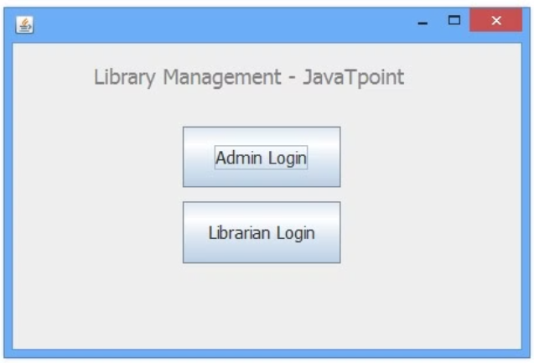
Login
Login Credentials
Next Steps
To access the system, enter "admin" for the username and "admin123" for the password.
Once logged in, you can manage librarians, books, and issued books.
Notes:
2

Slide 3

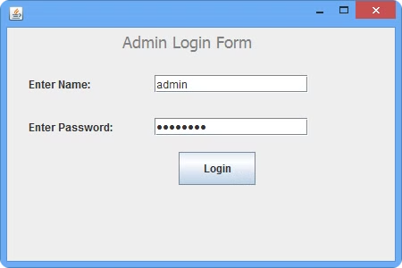
Librarian Management
1
View Librarian Records
2
Delete Librarian
Click "Delete Librarian" to remove a librarian from the system.
Click "View Librarian" to see a list of all librarians.
3
Deletion Confirmation
After deleting, confirm the librarian is removed by clicking "View Librarian" again.
Notes:
3

Slide 4

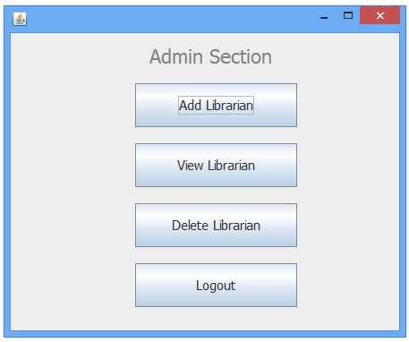
Book Management
Add Books
View Book Records
Add new books to the library system.
View the list of all books in the library.
Confirm Book Addition
After adding, click "View Books" to verify the new book is included.
Notes:
4

Slide 5


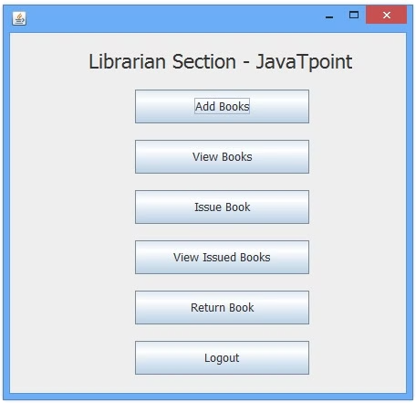
Issuing Books
Issue Book
Click "Issue Book" to check out a book to a student.
View Issued Books
Click "View Issued Books" to see a list of all currently issued books.
Confirm Issue
After issuing, confirm by viewing the issued books list.
Notes:
5

Slide 6

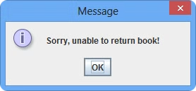
Book Return
Return Book
1
Click "Return Book" to return a previously issued book.
Enter Details
2
Provide the Call Number and Student ID of the book to be returned.
Confirm Return
3
Verify the returned book's record by viewing issued books.
Notes:
6

Slide 7


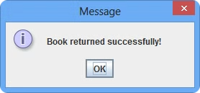

System Functionality
Book Issue
When a book is issued, its quantity is decremented, and the issued count is incremented.
Book Return
When a book is returned, the quantity is incremented, and the issued count is decremented.
Notes:
7

Slide 8

Conclusion
Thank you for watching! This Library Management System, developed by Ankush Lagwal while training in core Java, provides an intuitive and efficient way to manage your library's operations. With its user-friendly interface and robust functionality, it offers a complete solution for your library management needs.
Notes:
8

